Slide 1
WRITING
CLEAN CODE

Slide 2
Why should we write clean code?
Better visual perception
Easier to start or continue
Better for teamwork

Slide 3
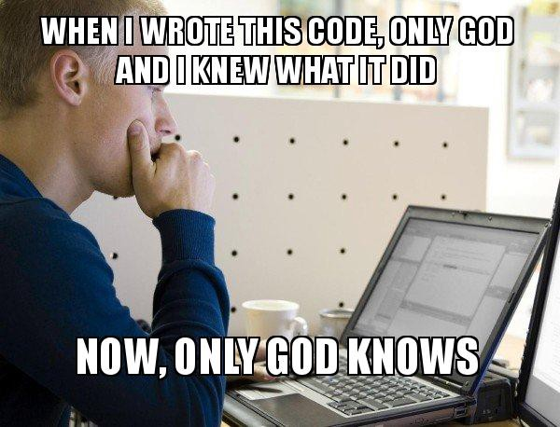
Make the code understandable to people

Slide 4
The easiest way is to use spaces. It's normal to shrink our code before we send it. However, you do not need to write code that looks reduced. Instead, we can use indents, line breaks, and blank lines to make our code structure more readable. When we decide to adopt this practice, the readability and intelligibility of our code can be greatly improved. Then one look at our code may be enough to understand it. Let's look at two simple examples.

Slide 5
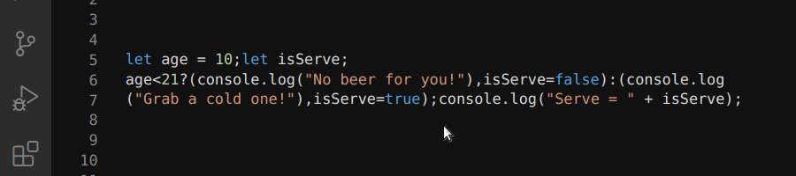
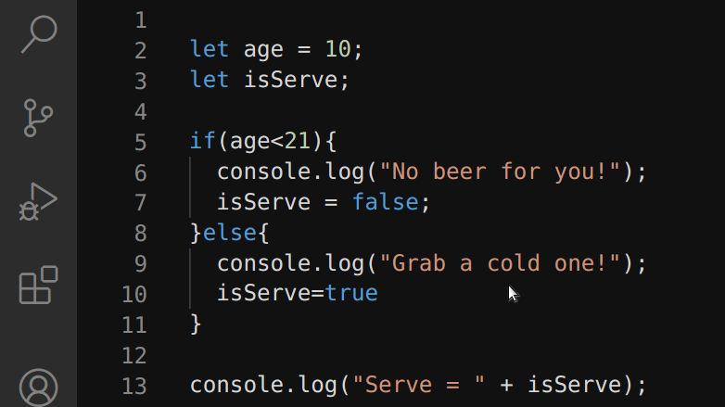
Hard to read
It’s better

Slide 6
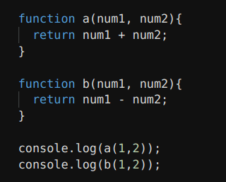
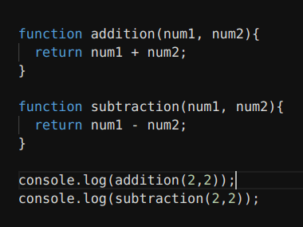
Use meaningful variable and function names
Hard to read
It’s better

Slide 7
What does significant mean? Significant names are descriptive names enough for other people, and not just us, to understand the purpose of a variable, function, or method. In other words, the name itself should indicate what the variable, function, or method is used for or what it contains. A good rule of thumb is to limit names to three or four words. If we need to use more than four words, we may be trying to do too many things at once, and we need to simplify the code.

Slide 8
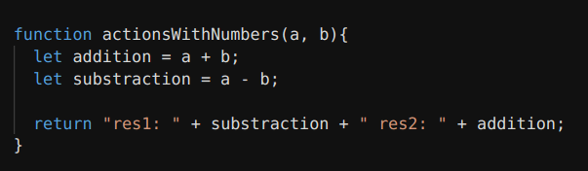
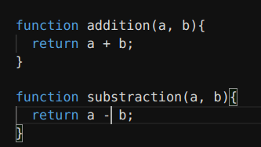
A function or method uses only one task
Bad
Good

Slide 9
The function does not have to be adapted to all occasions. So it becomes large in functionality and in essence for a particular case. It can be reused very rarely. And it's hard to find the name of such a function. Sometimes you can get confused by what you write. This creates a mess. Instead, you can use functions that perform only one task. This practice was introduced by Robert Martin as one of the five object-oriented design principles, also known as SOLID, but more on that later ....

Slide 10
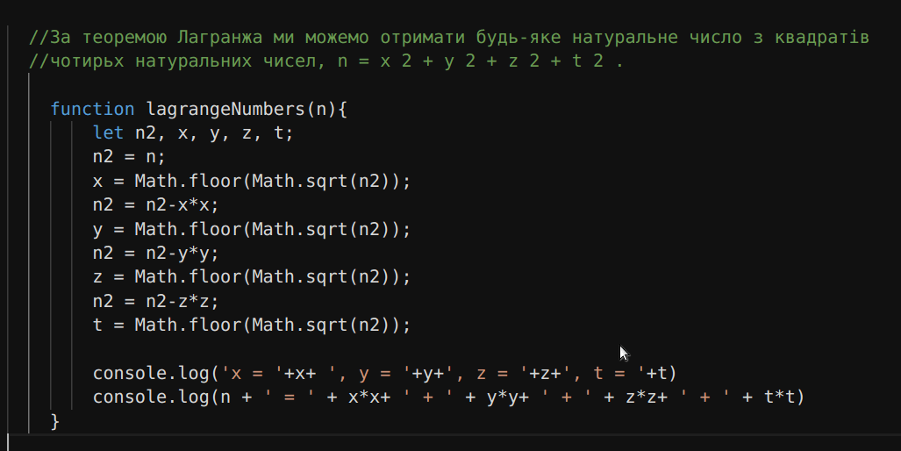
Use comments for clarification

Slide 11
No matter how hard we try to come up with meaningful names for our variables, functions, and methods. Our code itself is not as perfect as it may be. The problem may be that it is difficult to understand or use. Sometimes we don't know why we implement a function or method or why someone created it that way. Also, when we find ourselves in a situation where we have decided to use a hack, a quick fix or an unconventional approach. So you need to use the comments to explain why we did what we did. It is better to use one or two lines for a comment with explanations than to make people guess.

Slide 12
Follow the sequence
When we find a specific coding practice or style that we like, we need to stick to it and use it everywhere. Using different coding methods or styles in different projects is not a good idea. A project written in different styles is like a book in different languages. There is always someone in this situation who does not understand something. Therefore, there are generally accepted norms that must be followed. For example, those shown in the next slide.

Slide 13
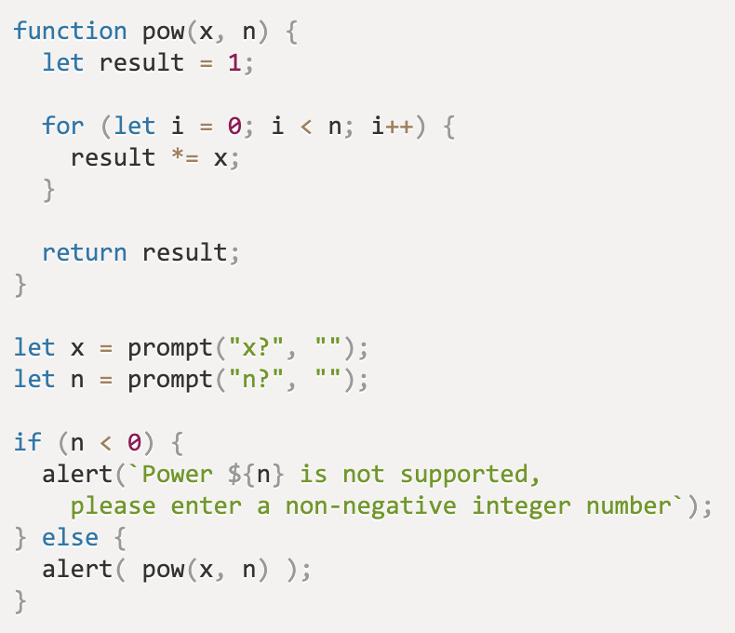
No spaces between the function name and the first parenthesis
Space between parameters
The first curly brace in the same line after the space
Indent 2 spaces
Spaces around the operators
Space after for / if / while
A semicolon is required
Space between parameters
Blank tape between logical blocks
Space between parameters
} else { without line wrapping
Spaces for nested call

Slide 14
Regularly review your code
Just writing clean code is not all. Our work is not finished with the last semicolon. The next step is to maintain the purity of our code. Clean code requires maintenance. When we write something, we need to review it regularly, clean it up, and try to improve it. The same software updates that everyone gets on their phone are the result of regularly reviewing and improving previously written code. This is an opportunity to do better.

Slide 15
Modular tests are the guardians of the quality of your code. By covering your code in time with modular tests, you review yourself and your code. In the future, modular tests and test development will help identify weaknesses and identify where program behavior is distorted or disrupted.
Refactoring. This is what makes your code clean, beautiful, advanced and easier to understand. There is always room for improvement. Refactoring should be done carefully and in small pieces so that you do not spoil one part while trying to fix the other.

Slide 16
SOLID principles
SOLID is an abbreviation of the first letters of the five basic principles of object-oriented programming and design proposed by Robert Martin.
SOLID principles are used to design and develop software systems that are likely to be able to develop, expand and maintain for a long time.

Slide 17
S - Single Responsibility Principle (SRP) - Each software module has one and only one reason for change. As software systems change to meet the needs of users and the satisfaction of stakeholders, we can reformulate the principle as follows: "Each module must be accountable to one and only one user or stakeholder." Suppose we have an Employee object, it has three functions: calcuPay (), reportHours () and save ().

Slide 18
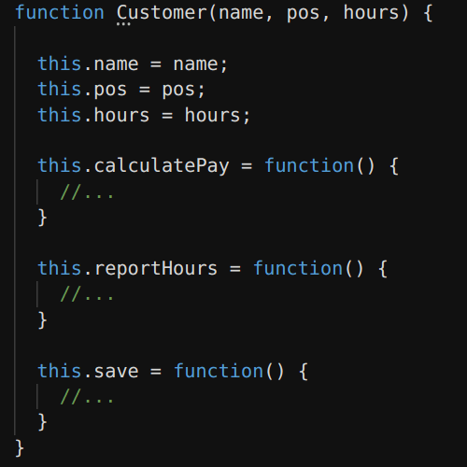
This structure violates the SRP,
because:
- calculatePay () is responsible for accounting
- reportHours () is used by the HR department
- save () is determined by database administrators
To avoid this problem, you need to separate the code

Slide 19
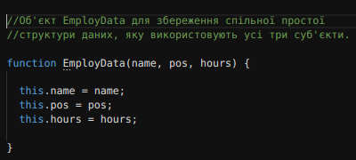
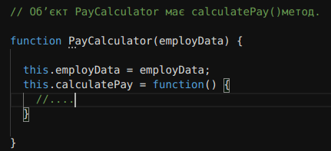
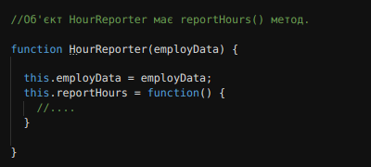
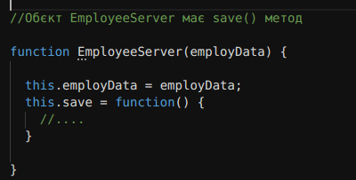

Slide 20
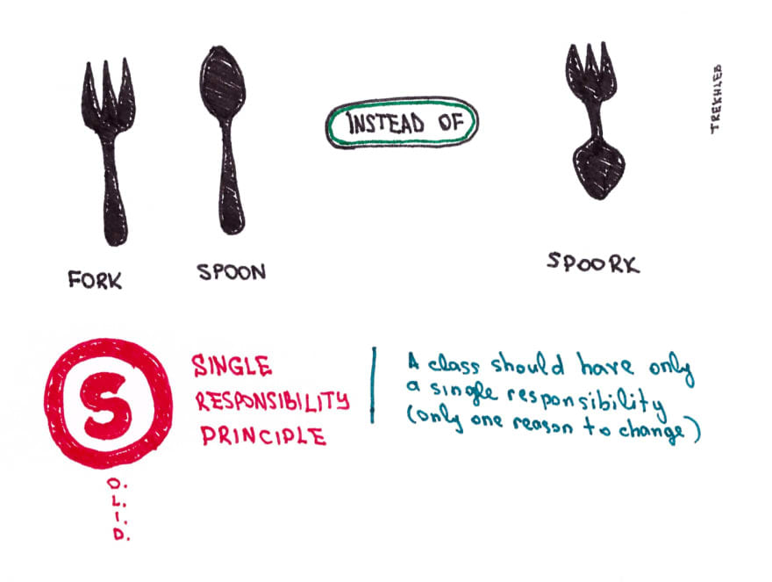

Slide 21
O - Open Closed Principle (OCP) is an important principle of object-oriented programming, which means that “program entities, such as classes, modules, functions, methods, etc. should be open to expansion and closed to change. " This means that they can provide the ability to change their behavior without or with minimal code changes. Suppose that each employee has his own profession and grants privileges. But what if we introduce a new profession into the system and do not change existing things. So we can do as shown in the example below to make it pass OCP.

Slide 22
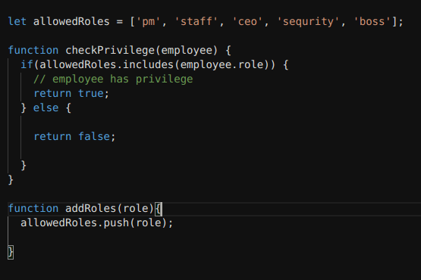

Slide 23
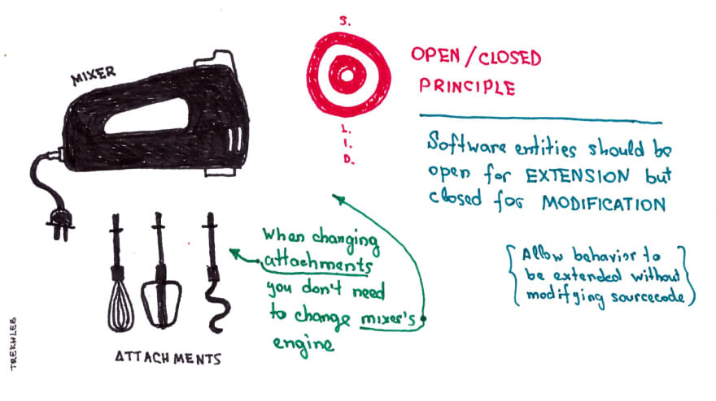
We don't need to modify existing code, but we can extend it to add a new role. OCP is one of the driving forces of systems architecture. The goal is to make the system easy to expand without being significantly affected by the changes.

Slide 24
L - Liskov Substitution Principle (LSP) - to build software systems from interchangeable parts, these parts must follow a rule that allows you to replace these parts with one another. In the context of JavaScript, this means that:
- Subclass methods that replace base class methods must have exactly the same number of arguments.
- Each argument and return type of the overridden method must be of the same type as in the base class method.
- The types of exceptions dropped from the override method must be the same as the base class method.

Slide 25
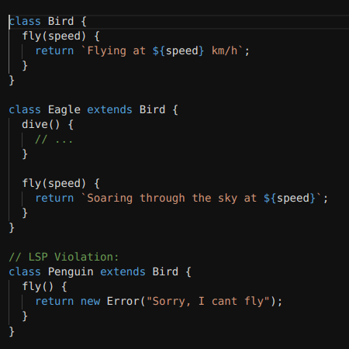
The best way to explain LSP is to give an example:

Slide 26
In this example, the Eagle class changes the fly method, but this does not violate the LSP, because writing new methods is compatible with the base method class. Subclass methods that replace base class methods must have the same number of arguments. The LSP does not insist that the return value of the overridden method should also be the same.
The Penguin class violates the LSP in two ways:
1. The overridden fly method does not have the same number of arguments.
2. The return type of the fly () method is not the same as the parent

Slide 27
I - Interface Segregation Principle (ISP) Customers should not depend on methods they do not use. Therefore, this principle means that too "thick" interfaces should be divided into smaller and specific so that customers know only about the methods that are necessary for them to work. As a result, when a certain functionality changes, those classes that do not use it should remain unchanged. That is, following this principle helps the system to remain flexible when making changes and to remain simple for refactoring.

Slide 28
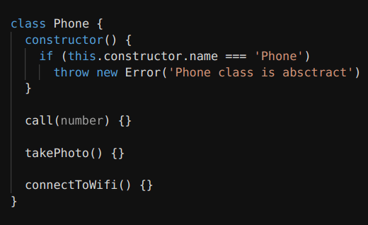
Let's define an "abstract" Phone class that will play the role of an interface in our case:

Slide 29
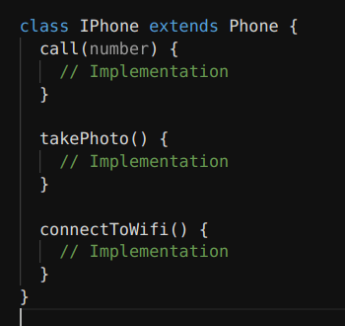
Can we use it to identify the iPhone?

Slide 30
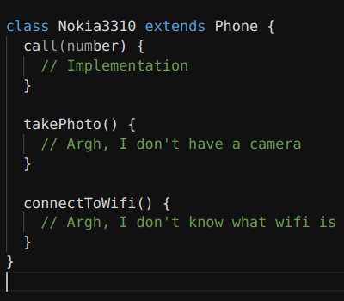
Okay, but for the old Nokia 3310, this interface will violate the "I" principle

Slide 31
D - Dependency Inversion Principle (DIP) - the essence of the principle is to break the connection between software modules of higher and lower levels through common abstractions. The principle is formulated as follows:
- Higher level modules should not depend on lower level modules. Both types of modules must depend on abstractions.
- Abstractions should not depend on the details of implementation. Implementation details should depend on abstractions.
The principle of dependence inversion solves the problem of failed program design.

Slide 32
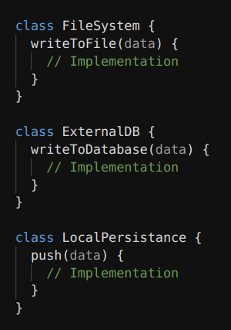
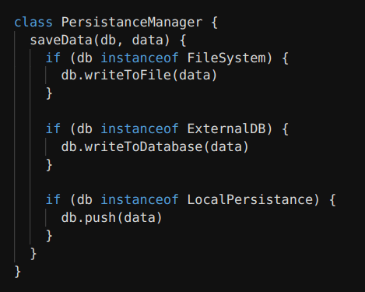
Here the high class depends on the low level classes.

Slide 33
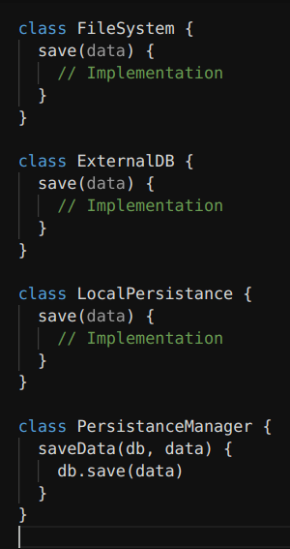
To avoid problems in this simple case, we need to do something similar.

Slide 34
Useful links
https://gist.github.com/wojteklu/73c6914cc446146b8b533c0988cf8d29
https://levelup.gitconnected.com/javascript-clean-code-solid-9d135f824180
https://medium.com/javascript-in-plain-english/javascript-clean-code-best-practices-461c24c53cae
https://github.com/ryanmcdermott/clean-code-javascript
https://dzone.com/articles/6-tips-to-help-you-write-cleaner-code-in-nodejs
https://thenextweb.com/syndication/2020/07/25/how-to-write-cleaner-code-with-javascript/

Slide 35


